Slide 1

Staff Meeting
FY24 Board Approved Budget Review
June 22, 2023

Slide 2
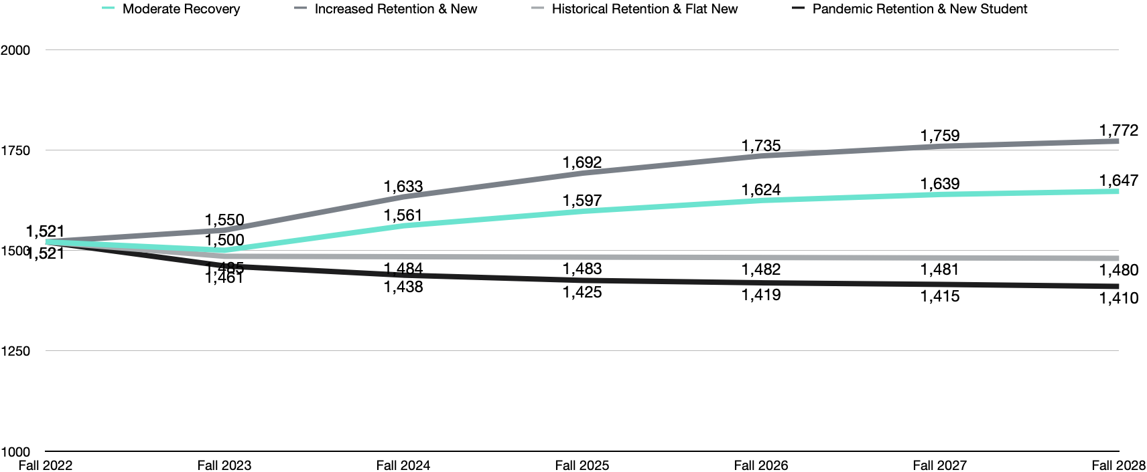
Model Comparison - Total Enrollment
Notes:
T

Slide 5
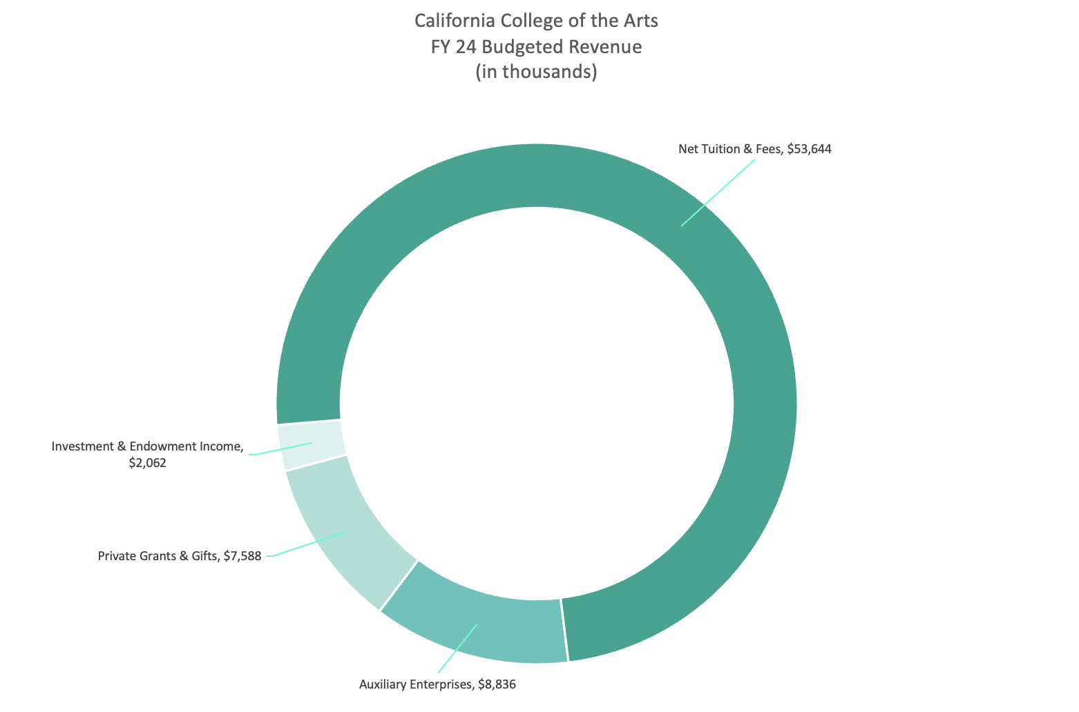

Slide 6
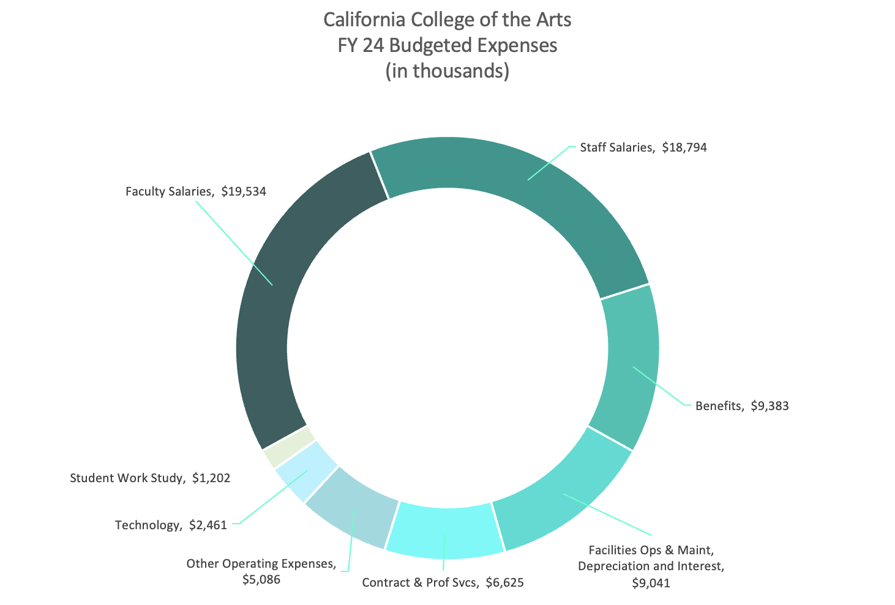

Slide 7
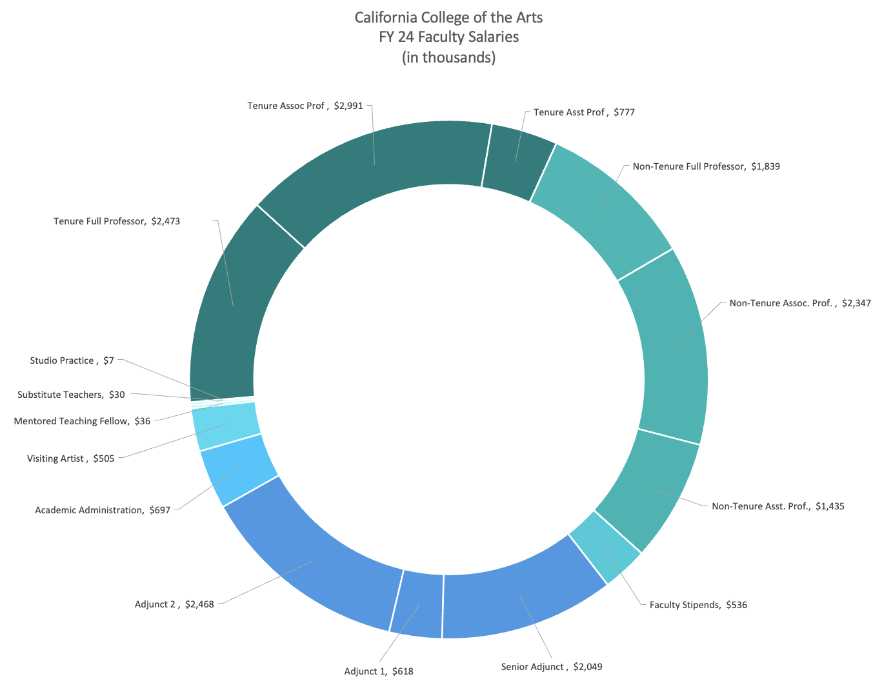

Slide 8
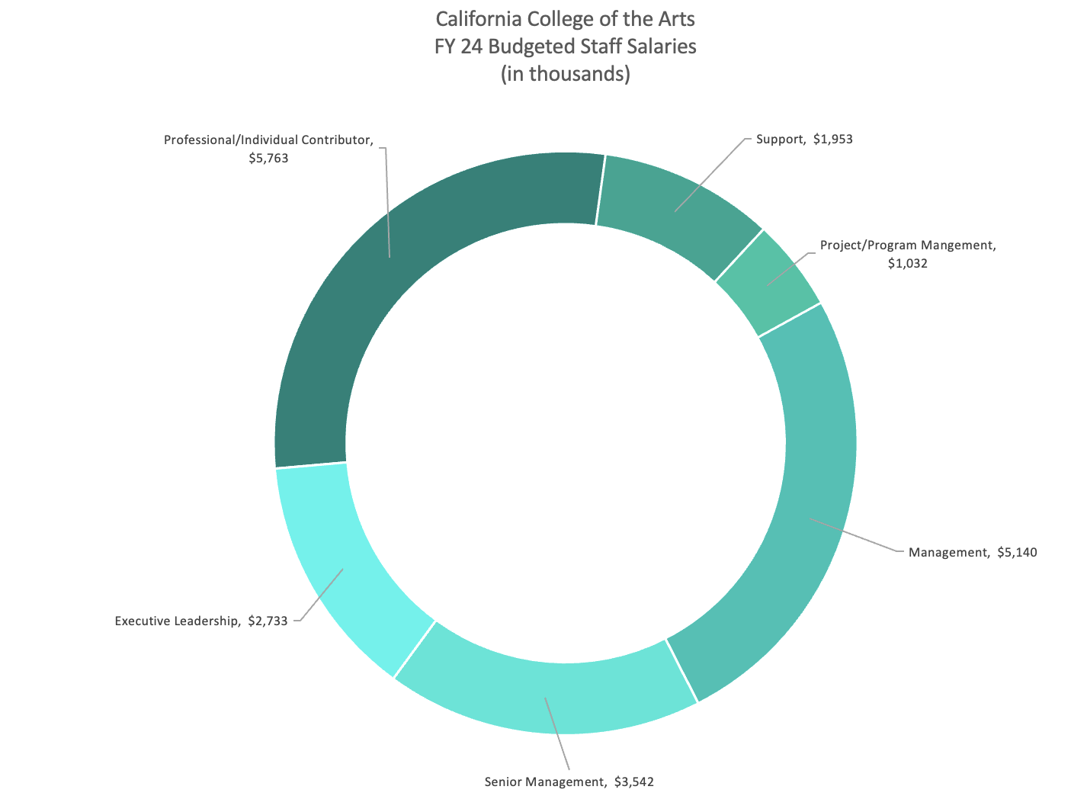

Slide 9
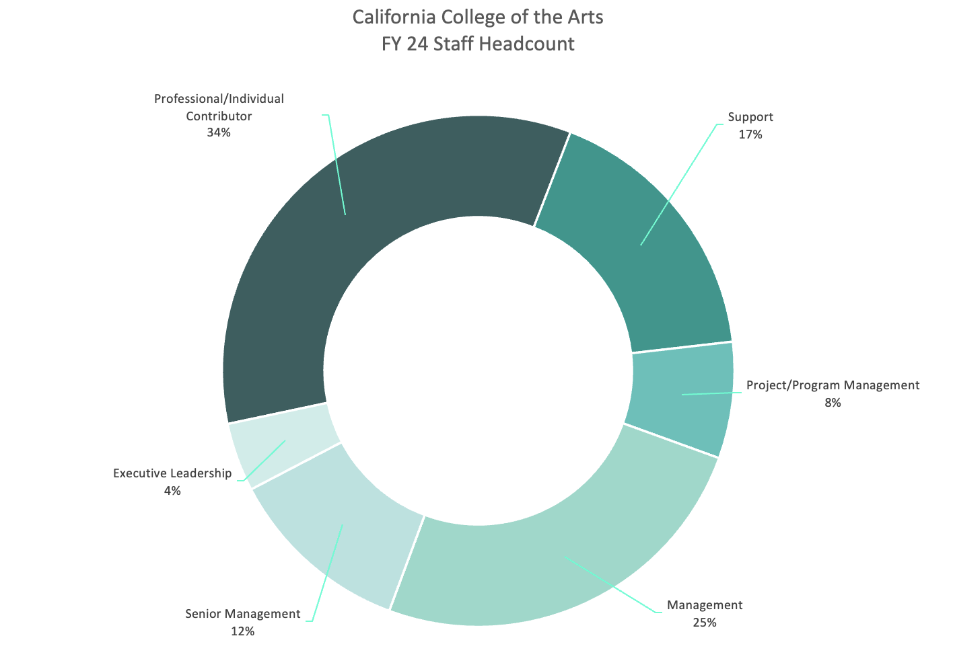

Slide 10
Questions

